Slide 1
Topic: Solving Equations with backtracking. EQ: How do I use the backtracking method to solve equations?

Slide 2

Solving Equations
Learning Objectives:
Able to solve a one-step equation
Able to solve a two-step equation

Slide 3
Solving Equations
When solving an equation, it’s useful to think of them as a function machine
To find the starting value, you work backwards through the function machine
You always do the opposite when working backwards

Slide 4
Solving equations
So
x = 11!!
Find the value of x if:
x + 9 = 20
x
+ 9
20
11
- 9
20

Slide 5
Solving equations
So
x = 46!!
Find the value of x if:
x - 13 = 33
x
-13
33
46
+ 13
33

Slide 6
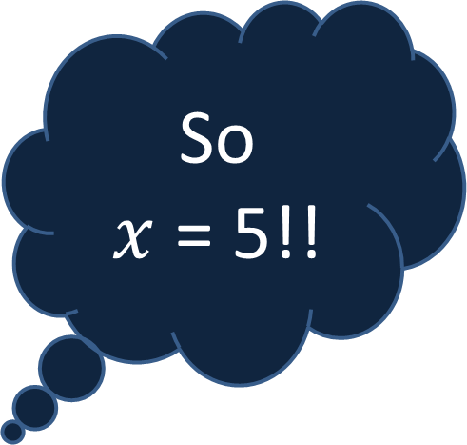


Solving equations
So
$x$ = 5!!
Find the value of $x$ if:
4$x$ + 7 = 27
$$x$$
x 4
+ 7
27
20
5
÷ 4
- 7
27

Slide 7

Solving equations
So
$x$ = 5!!
Find the value of $x$ if:
20$x$ – 15 = 85
$$x$$
x 20
- 15
85
100
5
÷ 20
+15
85

Slide 8

Solving equations
So
x = 15!!
Find the value of x if:
$$\frac{x}{3}=5$$
x
÷ 3
5
15
x 3
5

Slide 9

Solving Equations
Solve the following equations, showing your working out
a + 5 = 12
b – 6 = 20
c + 17 = 32
d – 9 = 36
e + 26 = 51
a = 7
6) 2f + 3 = 9
4g – 15 = 9
7h – 20 = 15
10i + 27 = 97
$\frac{j}{5}$ + 9 = 17
f = 3
b = 26
g = 6
c = 15
h = 5
d = 45
i = 7
e = 25
j = 40

